Slide 1
Frankenstein
Mary Shelley

Slide 2
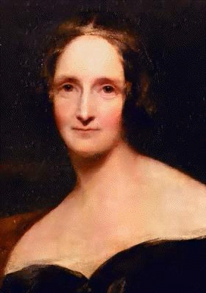
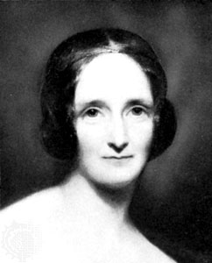
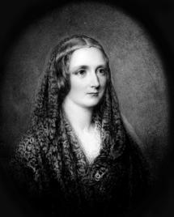
Mary Wollstonecraft Godwin: 30 August 1797 – 1 February 1851

Slide 3
Frankenstein is born
I n the summer of 1816, a young, well-educated woman from England traveled with her lover to the Swiss Alps. Unseasonable rain kept them trapped inside their lodgings, where they entertained themselves by reading ghost stories. At the urging of renowned poet Lord Byron, a friend and neighbor, they set their own pens to paper, competing to see who could write the best ghost story. The young woman, Mary Wollstonecraft Godwin only 18 at the time, took the prize, having composed a story creepy enough not only to take its place alongside the old German tales that she and her Alpine companions had been reading, but also to become a bestseller in her time and a Gothic classic that still resonates with readers almost two centuries later.

Slide 4
Mary is born in Great Britain in 1797 to well-known parents but unfortunately, her mother dies in childbirth.
At the age of 16, Mary meets the young poet Percy Bysshe Shelley who is married at the time. Later, his wife drowns herself so Mary and Percy get married.
They travel around Europe together and it is in Switzerland that Percy’s close friend, the poet Byron, suggests that Mary, Percy, Polidori (another friend) and himself each writes a ghost story. Mary’s Frankenstein is the only story of the four that gets published as a novel.
The last years of married life are filled with disaster for Mary. Her half sister dies as do two of her children. Mary becomes depressed, a tendency she probably inherited from her mother. She is only partly relieved by the birth of Percy, their only surviving child out of the four she had given birth to.
Mary and Percy eventually move to Italy where Percy drowns during a sailing trip in 1822. Mary is determined to keep the memory of her late husband alive.

Slide 5
Frankenstein-the novel
‘Frankenstein’ is an epistolary novel (written as a series of letters between the main characters) belonging in the Gothic genre. It is a story about a young Swiss student, who discovers the secret of animating lifeless matter and, by assembling body parts, creates a monster who vows revenge on his creator after being rejected from society.

Slide 6
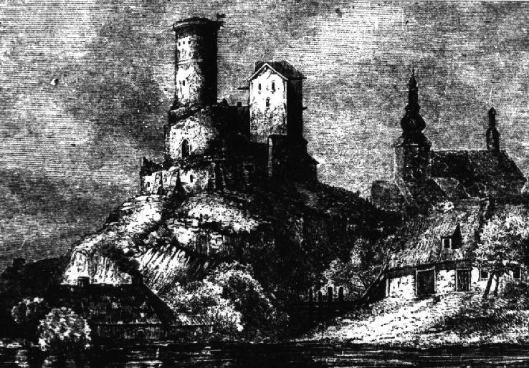
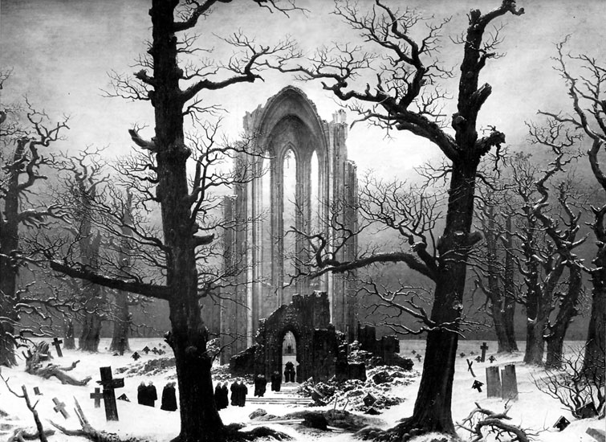
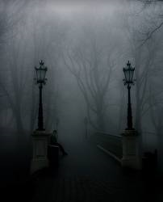
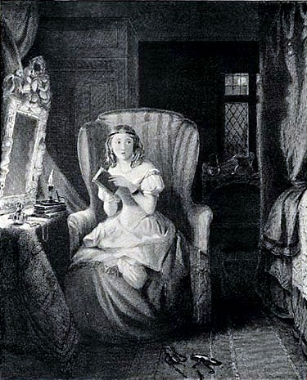
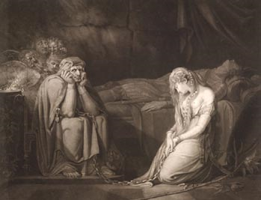
The Gothic Novel
What phrases, images, settings, characters do you associate with the word ‘Gothic’?
graveyard
monster
suspense
Inexplicable events
Impending doom
visions
Fearing the unknown
supernatural
vampire
Disturbing dreams
omens
sorrow
loneliness
ghosts
shadows
terror
death

Slide 7
Popular in the late eighteenth and early nineteenth centuries, Gothic fiction is a genre of literature that combines elements of both horror and romance. It is a genre characterized by the use of intense emotion, the characterization of nature as a powerful and destructive force, the use of weather and atmosphere to depict mood, and the evocation of terror and horror.

Slide 8
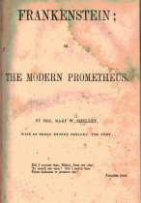
Frankenstein: The Modern Prometheus
‘The Modern Prometheus’ is the subtitle of the book, which refers to the figure in Greek mythology who was responsible for a conflict between mankind and the gods.

Slide 9
Greek myth: Prometheus, the fire stealer
In order to help the people, Prometheus stole Zeus's fire from the sun. The people were thereby given an advantage to the animals since fire gave man the ability to make weapons and tools. Prometheus was severely punished by Zeus who chained him to a rock in the Caucasus. Every night, Prometheus was visited by an eagle who ate from his liver. During the day, however, his liver grew back to its original state.

Slide 10
Prometheus, the animator
It also refers to the story of Prometheus plasticator who was to said to have created and animated mankind out of clay.
These two myths were eventually fused together: the fire that Prometheus had stolen is the fire of life with which he animated his clay models.
Because of the 'creating' aspect, Prometheus became a symbol for the creating artist in the eighteenth century.
?
How can Victor be seen as the modern Prometheus?
In what way does Victor defy God?

Slide 11
The three main characters: Victor Frankenstein
Victor Frankenstein is the eldest son of a wealthy, Genevese man, Alphonse, and his young wife, Caroline. Victor grows up in the perfect family with a happy childhood and a constant and devoted companion in his adopted cousin, Elizabeth. He is sensitive, intelligent, and passionate about his interests and becomes absorbed in the quest to find out what creates life. While away at college in Ingolstadt, Victor creates a being from scavenged corpse parts and gives it life, but is repulsed by its hideousness once it lives. The monster, in retaliation for Victor's negligence, destroys his life by killing off those Victor loves. Victor chases him to the far reaches of the Arctic planning to destroy him and then die to escape his misery and remorse at his creation, but he dies aboard Walton's ship before he can catch the monster.

Slide 12
Robert Walton
ROBERT WALTON is the indirect narrator of the story, he tells Victor Frankenstein's story through letters to his sister, Margaret Saville. Walton is a self-educated man who set out to reach and explore the North Pole and find an Arctic passage to connect the Atlantic and Pacific Oceans. While his ship is locked in ice, his crew sees Frankenstein's monster pass by on a dog sled and Frankenstein himself, exhausted and weakened, not far behind. They take Frankenstein aboard and Walton nurses him and talks with him because he has been longing for a friend. In seeing Walton's raw ambition to explore the North Pole at all costs, Frankenstein is prompted to tell the story of his destruction that a similar ambition brought upon him. After Frankenstein's death and just before the ship heads back to England, Walton is also the last to see the monster before he goes north to kill himself.

Slide 13
The Monster
THE MONSTER is created by Victor Frankenstein in Ingolstadt, and it is a conglomeration of human parts with inhuman strength. He is so hideous that Victor, his own creator, cannot stand to look upon him. He is loving and gentle at the beginning of his life, childlike in his curiosity and experiences, but after several harsh encounters with humans, he becomes bitter. He seeks revenge on his creator for making him so hideous and rendering him permanently lonely because of his ugliness. He offers Frankenstein peace in exchange for a companion of like origin, but when Frankenstein does not comply, he vows to destroy him and begins killing off Frankenstein's friends and family -- those figures he most envies because he does not have them. After finding Frankenstein dead aboard Walton's ship, the monster goes further north with plans to destroy himself and end the suffering that Frankenstein began when he created him.
Notes:
The images are taken from ‘Mary Shelley’s Frankenstein’.

Slide 14
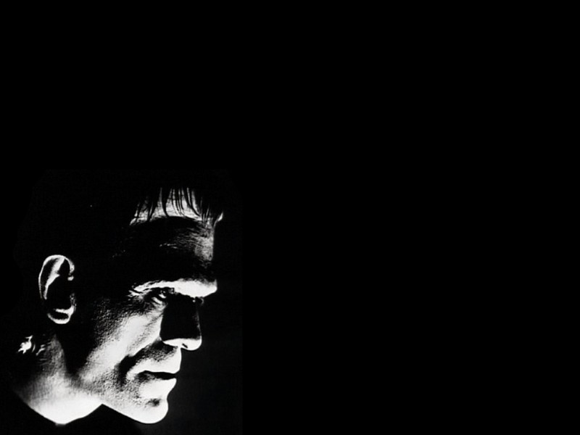
The faces of Frankenstein’s creature

Slide 15
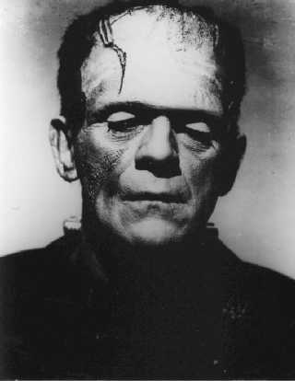
The most well-known face of Frankenstein’s monster is that of Boris Karloff, who played the role of the monster in the 1931 motion picture ‘Frankenstein’.

Slide 16
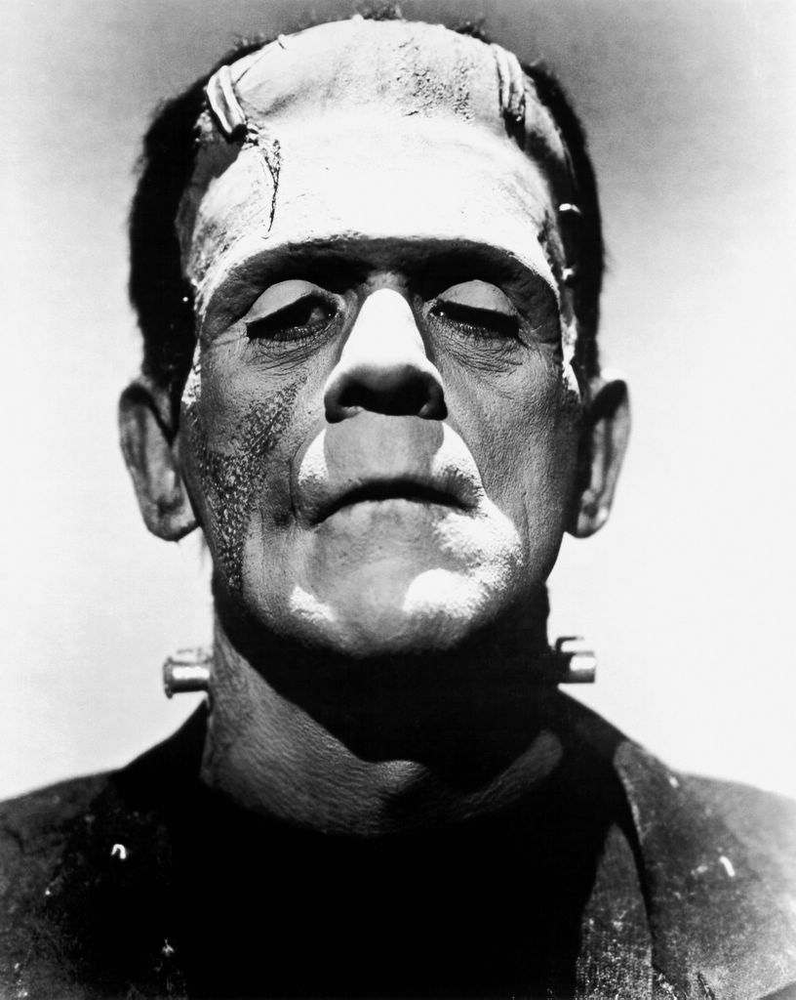
What are your first impressions of the monster?
?
What words would you use to describe him?
?

Slide 17
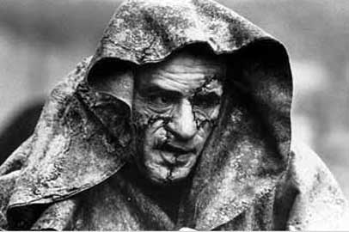
Here, the monster is played by actor Robert De Niro.

Slide 18
Pre-reading tasks The role of the family
Statement | True or false | Explanation
It is a parent’s job, more than society’s, to nurture his/her child.
With the advent of genetic engineering and “designer” babies, parents now have less important roles in the birth process.
All children are innately good.
Every child needs “mothering” in order to become “human.”
All parents love their children unconditionally, no matter how they look or act.
Children who are “deformed” physically or mentally should be isolated from society.

Slide 19
Pre-reading task
The Ancient Mariner
The Arctic
When the novel opens, the explorer, Robert Walton is organizing an expedition through the Arctic,
the area around and within the Arctic Circle and near the North Pole. The Arctic Ocean covers most of
this region, and more than half of the ocean’s surface is frozen at all times. Travel by ship is extremely
dangerous. Huge sheets of ice float through the frigid waters, threatening to crush the vessels that appear
in their paths.

Slide 20
Background information
Did You Know?
In the letters, which set the stage for the novel, Robert Walton says he has been deeply affected by the narrative poem The Rime of the Ancient Mariner, written by Samuel Taylor Coleridge, a leading poet of the Romantic era.
In the poem, an old sailor, or mariner, tells the story of a horrific sea voyage that changed his life. Sailing in stormy seas near the South Pole, the mariner’s ship is surrounded by ice. When the crewmen spot an albatross, a huge seagull-like bird, flying through the fog, the ice splits open, freeing the ship. Then, unexpectedly, the mariner shoots the albatross. After this act of cruelty, the ship is cursed. Driven north, it becomes stranded in a hot, windless sea. All of the crew except the mariner die. Ever since, the remorseful mariner has traveled the world to tell his story and to teach others to revere God’s creatures.

Slide 21
Literary term: Allusion
Walton’s comments about “The Ancient Mariner” are examples of allusion. An allusion is a reference in a written work to something from history, art, religion, myth, or another work of literature. Writers use allusions to give readers additional insights about what is happening in the story and why. Shelley makes frequent use of literary allusions in Frankenstein.

Slide 22
Frankenstein: Letters 1-4
Character comparison
Vocabulary
ardent adj. passionate
countenance n. face; expression
dauntless adj. fearless
harrowing adj. extremely distressing
irrevocably adv. in a way impossible to change
mariner n. navigator of a ship
perseverance n. steady persistence
 | Walton | The stranger
Situation | is searching for the source of magnetism in the polar regions
Goals
Personal qualities
Attitude

Slide 23
Questions on Letters 1-4
1. Is Walton a reliable narrator? Why or why not?
2. Is Walton’s goal to “confer on all mankind . . . a passage near the pole” noble or overly ambitious?
3. How does Robert’s desire for a friend affect his relationship with Dr. Frankenstein? How might this relationship affect the reader’s trust in Walton as a reliable narrator?
4. Why is the poem The Ancient Mariner important to Walton? How is the stranger similar to the ancient mariner? What mood does Shelley create by alluding to this poem?
5. Walton has a thirst for knowledge, as the stranger once did. What details suggest that both are willing to make sacrifices in the search for knowledge? Do they seem unusual in this respect?

Slide 24
Chapters 1-10
BACKGROUND
Two Well-Rounded Characters
In Chapters 1 through 10, Shelley develops the two main characters in the novel: Victor Frankenstein and his creature. She also introduces a number of minor characters. Both Frankenstein and the creature have complex and multifaceted personalities. In this regard, they stand out from the other characters in the novel.
When a fictional character has individuality and depth, and experiences personal growth or change, he or she is called a round character. The opposite of a round character is a flat character.
Round characters are life-like and three-dimensional, while flat characters seem more like cardboard figures or stereotypes, and are not as well developed.
Vocabulary
benevolent adj. showing charity
commiserate v. to express sympathy
consolation n. something that eases sorrow or disappointment
discern v. to detect; to perceive
fiend n. evil spirit; devil
hideous adj. extremely ugly
omen n. a sign of future good or evil

Slide 25
Background information
Did You Know?
Victor Frankenstein develops an interest in science after reading about the “wild fancies” of several noted alchemists who lived 300 to 500 years before his lifetime. Alchemy was a field of philosophy that speculated about natural processes and often involved chemical experiments. Medieval alchemists believed they could find substances that would enable them to transform ordinary metals, such as lead, into gold or create a magical drink that would extend life and youth forever. While alchemy is not true science, the alchemists did make some scientific contributions. They discovered mineral acids and alcohol. They also invented types of laboratory equipment and procedures, which were later modified and used by scientists.

Slide 26
Character analysis Chapters 1-10
In Chapters 1 through 10, the author introduces the two major characters in the novel as well as several minor characters. In the chart below, list each character and note important details about his or her background or personality.
Character | Important details
Victor Frankenstein | From happy home; thirst for knowledge; hard-working

Slide 27
Personal response to chapters 1-10
What do you think of Victor Frankenstein as a student and scientist? What do you admire or dislike about his goals? Explain.
Who is Elizabeth and how does Frankenstein feel about her? What does their relationship tell you about Frankenstein’s values and personality?
What is Frankenstein’s purpose in pursuing science? What does he study? How do you interpret Frankenstein’s initial response to the success of his experiment?
Frankenstein says, “I shunned my fellow creatures as if I had been guilty of a crime.” From your reading, give specific examples of Frankenstein’s isolation from others. What does this tell you about his personality? Explain.
How is Frankenstein affected by the knowledge that the creature may be responsible for the death of William? In Chapter 7, what statement suggests that he views the creature as part of himself? Do you agree with Frankenstein that he bears some responsibility for the death? Why?

Slide 28
Writing task
Thrills and Chills
Gothic novels emphasize horror, mystery, and the supernatural. Write an analysis of the Gothic features of the novel Frankenstein that are evident in Chapters 1 through 10. How does Shelley establish an atmosphere of mystery? How does the action create a feeling of terror in the reader? What supernatural elements does she include? Consider setting, plot, and character in your analysis.

Slide 29
Chapters 11-16
FOCUS ACTIVITY
What are some reasons why a person might be rejected by others?
Quickwrite
Describe on paper a situation in which a person might feel he or she has been repeatedly rejected by others. What emotional response might the person have?

Slide 30
Literary term: Tragedy
There are many definitions of tragedy. In literature, a tragedy is a story that ends in the downfall of its main character and arouses pity or fear in the reader. In general, tragedy also expresses a tragic view of life—the idea that a noble person inevitably brings on his or her suffering or death through some failure or error. As you continue to read Frankenstein, think about whether the novel fits this definition of a tragedy.

Slide 31
Background information
The Fallen Angel
Do these words sound familiar? “Did I request thee, Maker, from my clay / To mold me man? Did I solicit
thee / From darkness to promote me?” This quotation appears on the title page of Mary Shelley’s Frankenstein. It could have been spoken by Frankenstein’s creature. In fact, the words come from John Milton’s poem Paradise Lost (1667) and are spoken by the character of Adam. This book-length poem is a
retelling of the story of Adam and Eve from the Bible. An equally prominent character in the poem is Satan, the lord of evil. Milton depicts Satan as the chief angel of heaven who rebels against God and is cast into hell. To avenge himself, he tempts Adam and Eve to disobey God in the Garden of Eden.
Near the end of Chapter 10 of Frankenstein, the creature confronts his creator. He compares himself not only to Adam but to “the fallen angel, whom thou drivest from joy for no misdeed.” In Chapters 11 through 16, Shelley expands on this allusion to Paradise Lost, emphasizing the parallels between God and Satan in the poem, and Frankenstein and his creature in the novel.

Slide 32
Chapters 11-16
Active Reading
Vocabulary
conjecture v. to guess using the available evidence
disconsolate adj. unable to be cheered up
enigmatic adj. puzzling
flagrant adj. highly offensive
pensive [adj. deeply or dreamily thoughtful
venerable adj. worthy of respect or reverence
vengeance n. punishment inflicted in return for a wrong
wantonly adv. maliciously; without restraint
In this section, the creature recounts what has happened in his life since Frankenstein abandoned him. Use the chart below to record the main experiences in the creature’s life as well as his thoughts and feelings about those experiences.
Experiences | Thoughts and Feelings
Discovers his senses; finds fire and food; observes the moon | Feels joy in discovering nature

Slide 33
Personal Response
What questions would you like to ask the creature?
How does the creature get to know the family who lives in the cottage? Why is he drawn to the family? How does the family’s reaction to the creature affect his view of himself and the human race?
After reading Paradise Lost, why does the creature think he is like Adam in that book? Why does he think he is like Satan? What are the specific reasons that the creature gives for hating his creator?
How does the creature cause the deaths of William and Justine? What does the murder of William tell the creature about himself? According to the creature, what can save him from doing evil?
Thus far, do you find the creature more or less sympathetic than the character of Victor Frankenstein? Explain.
How believable is the account of the creature’s education? Refer to the novel and your own experience in your answer.

Slide 34
Chapters 17-21
FOCUS ACTIVITY
Why is it important to love and be loved?
Think-Pair-Share
On a sheet of paper, write three reasons why companionship or love is an important part of the human experience. Then meet with another student and read your ideas aloud. Discuss, blend, and adjust your lists to come up with three reasons that you both agree on.

Slide 35
Literary term: Foreshadowing
Did You Know?
Tales of horror create suspense by raising questions or uncertainties about the action in the reader’s mind.
Sometimes we don’t know what will happen. As we read, we wonder who or what is responsible for the events that take place, or we wonder how the events came about. In other cases, the tragic outcome is
known or strongly hinted at the beginning of the story. As we read, the suspense comes from anticipating when the worst will occur or wondering if it can be prevented. Authors often increase the readers’ feeling of fear or dread through foreshadowing. They give hints that suggest or prepare the reader for a later event. Such hints, or foreshadowing, might take the form of a statement by a character, a mood established in the description of the setting, or the revelation of an important trait in one of the characters.

Slide 36
Tracing main events
climax
Frankenstein agrees to create a companion for his creature
Vocabulary
base adj. mean-spirited
inexorable adj. unyielding
insurmountable adj. impossible to overcome
irksome adj. annoying
listless adj. lacking energy
malicious adj. deliberately harmful
torpor n. state of inactivity or apathy
traverse v. to travel across
Notes:
Use the pyramid chart below to trace the main events that occur after Frankenstein agrees to create a companion for his creature. Use as many boxes as you need but record the climax, or turning point, of this part of the novel at the peak of the diagram.

Slide 37
Chapters 17-21 Personal response
Which of the events in this section of the novel surprised you the most and why?
What arguments does the creature use to persuade Frankenstein to make the female creature? How does Frankenstein’s decision affect Frankenstein’s mood and personal life?
What keeps Frankenstein from completing the second creature? In your opinion, why does the creature direct his revenge to Frankenstein’s wedding?
How does Frankenstein become lost at sea? What happens when he lands in Ireland? Why does he call himself Henry Clerval’s murderer?
How does Shelley create a feeling of suspense in Chapters 17 through 21? Did you find the events in Chapter 21 probable or improbable? Explain.

Slide 38
Writing task: Explanation for creating companion
The Second Time Around
Imagine that Victor Frankenstein has decided to write a letter to Elizabeth or his father that describes his thoughts about creating another creature. Take on the role of Frankenstein as you write a letter of explanation. You may want to compare Frankenstein’s creation of the second creature to his creation of the first one. Does he have the same motives or different
ones? Do you think his attitude toward such ambitious projects has changed?

Slide 39
Chapters 22-24 BACKGROUND-Dramatic productions
Five years after Frankenstein was published, Mary Shelley saw the first dramatic production of her novel. She liked the actor’s portrayal of her creature. How well she might like the hundreds of interpretations
since is interesting speculation. In the 1931 film Frankenstein, starring English actor Boris Karloff, the monster comes to life on an operating table after being zapped with electricity. Given a huge, squared-off skull and pale corpse-like skin, Karloff portrayed the monster as a gentle, almost childlike character. His interpretation struck a chord with audiences, especially young children, from whom he received much fan mail. In the 1995 film version of the novel, Mary Shelley’s Frankenstein, Robert De Niro, an actor known
for his violent tough-guy roles, was cast as the creature. The director, Kenneth Branagh, explained, “I wanted a wise and intelligent and multifaceted Creature who could be angry and even funny at times, and who would have a sense of humor, however darkly ironic.” To develop the physical appearance of the creature, make-up artists did research in books from the early 1800s on surgery, skin disorders, and embalming. They wanted to find out what Frankenstein would have been able to achieve using the techniques and knowledge available at the time. The result is a gray, scarred, hulking, patchwork sort of man.

Slide 40
Literary term: Doppelganger
Many people who have not read Shelley’s novel think that Frankenstein is the name of the creature, not the scientist who brought him to life. Careful readers of the novel, however, point out that this mistake has a certain symbolic truth. They see the two characters as doubles of each other, or two parts of a divided self. The idea of the double comes from German folklore and is known as the doppelgänger (“double goer”). The concept was based on the ancient belief that each living creature has an exact double who exists as a spirit or ghost. Many writers of horror stories have employed the idea of the double. For example, in Robert Louis Stevenson’s novella of double identity, The Strange Case of Dr. Jekyll and Mr. Hyde, a respectable doctor becomes a murderous stalker by night.

Slide 41
Using Evidence
Vocabulary
adversary n. enemy; opponent
consternation n. state of confusion
illustrious adj. very distinguished
omnipotent adj. all-powerful
pilgrimage n. long journey for a spiritual purpose
In the final chapters of the novel, Victor Frankenstein and his creature are involved in a mad contest of revenge. In the chart below, record at least four statements made by each character that reveal his motives, feelings, or state of mind. Note the chapter number after each statement.
Frankenstein
“Human beings, their feelings and passions, would indeed be degraded if such a wretch as I felt pride.” (Chapter 22)

Slide 42
Chapters 22-24 Personal response
Did the ending of the novel surprise you? Can you imagine a different ending to the novel? Explain.
What does Frankenstein promise to tell Elizabeth after they are married? How does he behave in the weeks leading up to their wedding? Why is Frankenstein especially agitated as evening approaches on their wedding day?
What happens to Elizabeth? What is ironic, or unexpected, about the creature’s revenge on Frankenstein? What does Frankenstein resolve to do?
How does Shelley show that Frankenstein and the creature are both obsessed with revenge? Does either of them win? Explain.
How does Shelley return to her frame story in Chapter 24? What effect does she achieve by using this frame story?
How do you think Frankenstein failed or erred as a human being? What traits or attributes, do you think, led to the creature’s fate?

Slide 43
Writing task
On board Walton’s ship, the creature sees his creator for the last time. If they had had a chance to talk at this point, what might they say to each other at the end of their long chase? Write a dialogue that reveals each character’s feelings about the other and about himself.
You may wish to incorporate or paraphrase quotations from the novel. Make sure your dialogue accurately conveys the character’s attitudes, feelings, and insights. After you have written your dialogue, ask two other students to read it aloud and offer comments.

Slide 44
Literary term: Theme
The theme of a novel is the main idea, moral, or message that sticks with the reader long after reading the book. Themes often explore timeless and universal ideas and are almost always implied rather than stated explicitly.
What are the ideas, messages or morals of ‘Frankenstein’?
?

Slide 45
Themes in ‘Frankenstein’
Family
Responsibility
Justice
Isolation
Prejudice
Knowledge and discovery
Secrecy
Themes

Slide 46
Finding evidence
Look for evidence in the novel supporting these points:
Walton’s desire for a friend establishes a major thematic meditation of the text: that being alone in the world creates the desire to have a circle of family and friends. This desire of Walton’s mirrors the later desire of the monster to have a companion. (Letter 2)
Although Elizabeth is welcomed into Victor’s full, happy family, her status as an orphan reminds us that family that can be destroyed at any moment. The threat of being alone is always present. (Chapter 1)
Victor establishes his family as a happy one, and his parents as the bringers of "many delights." Victor knows what a blessing it is to have your creators care about you, yet this knowledge does not compel him to do the same for the creature to whom he gives life. (Chapter 2)

Slide 47
Continued...
The loss of Victor’s mother serves as an omen of the loss he is going to encounter again and again as the story progresses. At the same time, her death establishes that family is what is most dear to Victor, what he most sorely does not want to lose. (Chapter 3)
Loss haunts Victor from a very early point in the book: his mother’s death is an "irreparable evil" from which all future evil and loneliness spring. (Chapter 3)
The monster longs for companionship with the family he observes, but he cannot engage with them because he is unacceptable to society. Instead, he must remain entirely alone. (Chapter 12)

Slide 48
Continued...
The monster refers to the family as "my" cottagers, implying his sense of connection to these people and his desire to be included in their family. Despite this, he knows he suffers the "fatal effects of this miserable deformity" and will be kept separate from them. (Chapter 12)
The monster’s desire for love and familial affection makes him a deeply human and sympathetic character. Yet it also drives him to commit his immoral acts. (Chapter 12)
The monster’s desire for a female companion parallels Adam’s asking God for a woman. (Chapter 17)
As the monster learns about the world and becomes educated, he realizes he is utterly alone and alienated from society. He has no "mutual bonds" to anyone – except Victor, who has rejected him. (Chapter 13)
Notes:
Teacher, see answer sheet.

Slide 49
CLOSING ARGUMENTS SPEECHES
Take the role of an attorney presenting his/her “closing arguments” at the end of a criminal trial. In this case either Victor Frankenstein or his creature is on trial. The crime can be varied: playing God, blind ambition, desertion, cruelty, or murder. Choose whether to defend or prosecute the character. To prepare your case, list all the possible arguments from both sides. For example, if you plan to defend Victor Frankenstein, list not only all the arguments you plan to use but also as many arguments as you can think of that will be used by the prosecution. Then, you’ll list possible responses to the opposition’s points. In this way, not only do you consider both points of view but you will also illustrate your skills in persuasive writing and speaking. Try to use your own opinion but cite the novel whenever possible.

